Slide 1
Te Ara Manaaki i ngā Kaumātua 2023 Te manaaki i ngā kaumātua o tō tātou rohe hei ngā tau e heke mai ana Age Friendly Approach 2023 Future proofing our district for our ageing communities
Notes:
Here to give update of our progress in the implentation of the age friendly approach.
John Hayes Chairman Age Friendly Reference group, Kevin is chair of the from OPC.

Slide 2
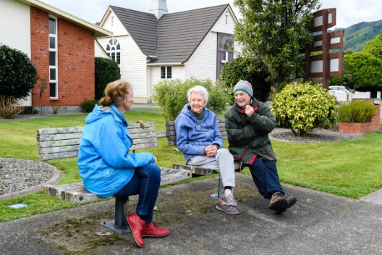
What is “Age Friendly”?
Led by World Health Organisation
​
Notes:
World Health Organisation:
WHO began work on Age Friendly Cities in 2006, and in 2007 published ‘Global age-friendly cities: a guide’
In 2010, the WHO Global Network for Age-friendly Cities and Communities was established.
National:
Our approach is part of the Age Friendly Aotearoa New Zealand programme led by the Office for Seniors. New Zealand’s involvement with the Age friendly Cities and Communities movement began with Tauranga City Council’s launch of its Age friendly City Strategy in 2012. In 2018 Hamilton became the first New Zealand city and 600th affiliate to the Global Network – since then Kapiti, New Plymouth, Hamilton, Gore, Nelson, Tamaki Makaurau/Auckland have joined the Global Network.
This contributes to New Zealand’s response to the United Nations Decade of Healthy Ageing 2020-2030
Based on the World Health Organization’s Age-Friendly Cities and Communities Framework which seeks to foster healthy and active aging across a range of domains including:
outdoor spaces and buildings
transportation
housing
social participation
respect and social inclusion
civic participation and employment
communication and information
community support and health services.

Slide 3
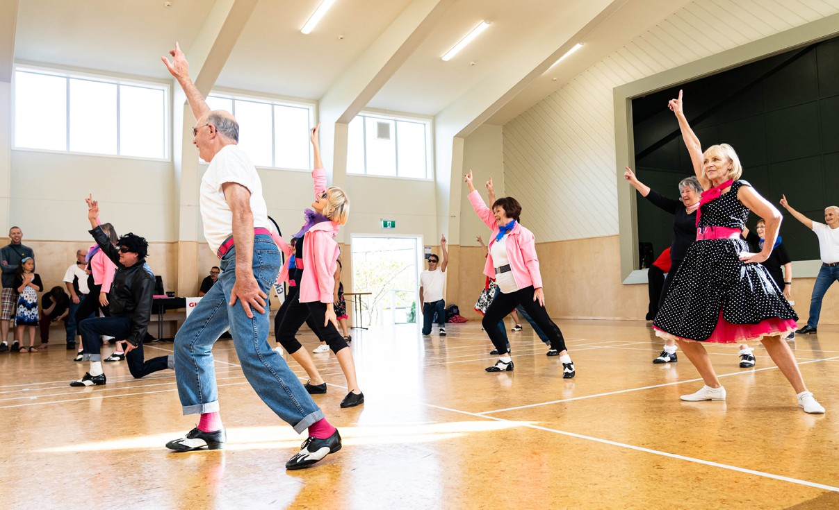
Ō mātou moemoeā​
Our vision​
Kia rongo ai ō tātou kaumātua ki te manaakitanga, kia whai pānga, kia whai wāhi hoki rātou ki te tautoko, i ēnei rangi tonu me te anamata.
Our older people feel cared for, connected and able to contribute, now and into the future
Notes:
If our older people feel cared for, connected and able to positively contribute to the district, they feel valued and have an increased sense of wellbeing.
"An Age Friendly strategy is a starting point for building a community suitable for all ages. A place where people grow and thrive whatever their age"
Kāpiti Coast District Council’s Age Friendly Approach seeks to value and support ageing in Kāpiti with a focus on those aged 65 and over. An age friendly Kāpiti is one which:
• recognises the wide range of capacity and capability of our older people
• future-proofs and responds to positive ageing needs and interests
• is inclusive and celebrates older people’s diverse identities and lifestyles
• is safe and accessible for older people and addresses inequities.
Aotearoa New Zealand has an aging population and the population in Kāpiti is aging faster than the national average. Council has a significant role to play in improving outcomes for older people and addressing the barriers they face.
Council cannot achieve an age friendly Kāpiti by itself. We will work alongside the diverse and vibrant range of organisations, facilities and services to improve the lives of our older people in Kāpiti, as well as advocate to central government on their unique needs. The community has been at the heart of the development of our approach. Over 1,000 members of the community have provided their time and thoughts which have formed the vision, values and focus areas of our approach.

Slide 4
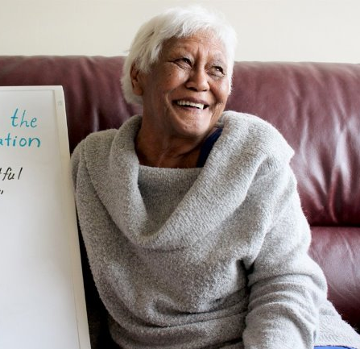
Our approach was built on the voices of our older people
Key themes:
Community design
Wellbeing
Accessibility
Meaningful opportunities
Notes:
Our Community
Across Aotearoa, our older population is rapidly growing, and Kapiti has a disproportionate number. Kāpiti has more than 15,400 residents aged over 65. That’s 26 percent of its population, compared to 16 percent nationally, and is expected to grow to 30 percent in the next 25 years. About 3.8 percent of Kāpiti residents are over 85 years old, compared to 1.8 percent nationally.
Our older community fed into the approach, through surveys, face to face meetings, interviews.
What we heard:
design communities with us in mind , provide us with meaningful opportunities to contribute to decision-making.
Many commented being age friendly would benefit everyone and felt it was an inclusive way of designing our communities.
They talked about wanting to have a more age friendly ‘feeling’ in our outdoor spaces and provided a range of practical suggestions such as more shade, comfortable seating and good lighting.
They shared their challenges with facilities including access to toilets, struggling with heavy doors and the need for planners to think about size, space, and how people move around and through our communities.
Being able to participate in our community in a way that suits them.

Slide 5
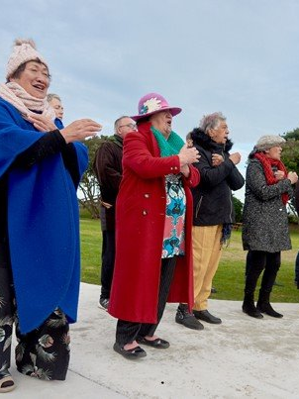
Ō mātou aronga
Our focus areas
Older people feel connected and valued as an integral part of our district
Older people can get around and have access to what they need
Older people participate in their communities in ways that work for them
Notes:
Through the development of our Age Friendly Approach, we heard that the following focus areas are important to our older people.​
Achieving these focus areas will mean we will have flourishing age friendly communities in Kāpiti.​
Focus areas:
Older people feel connected and valued as an integral part of our District
What we will see:
Older people can get around and have access to what they need
What we will see:
Older people participate in their communities in ways that work for them
What we will see

Slide 6
Better Off Funding
$100,000 Better Off Funding was allocated to the implementation of the Age Friendly Approach
Led by Age Friendly Reference Group with Connected Communities
Community workshop early in the year to define projects
Five funded community projects are underway
Notes:
Age friendly reference group and Council ran a workshop in April:
Gathering of community/social and health groups to workshop key focus areas, we identified gaps and potential projects in our community.
Better Off Funding: We received $100,000 through Better of funding for the implementation of the Approach, The Age friendly Reference group and Council looked at the identified gaps and what projects to fill them through non contestable grants. Based on these have the following projects rolling out:
Digital Seniors
$17,365
Launch Pilot program for one year which establishes Digital senior hubs in Kāpiti's four areas Otaki, Waikanae, Paraparaumu, Paekākāriki for broad access and impact
Age Concern
$24,689.00
An intergenerational project, looking at ways for older people in Kāpiti to share their knowledge and experience.
Meeting with Kāpiti Youth Council for potential to collaborate.
Volunteer Kāpiti
$15,000
Older Persons – sharing skills/knowledge, connecting and making a difference in the community through volunteering
Age Concern
“To provide different ways older people can find out about and participate in community activities”
Improve Communication
Hora te Pai
$15,000
Toi ora Kaumātua program: Provide social connection and support for older Māori people, through coordinated regular kaumātua māori meetings
All these projects groups will be meeting together in February to workshop and update how their projects are going to provide any learnings and insights.
Some projects are now in the planning stages of their projects:
Age Concern and Volunteer Kāpiti - Planning stages

Slide 7
Volunteer Kāpiti
Grant Funding: $15,000
A project to better access and celebrate the skills and knowledge of our older people through volunteering and to make a difference to our community through volunteering.
Notes:
Toiora Kaumātua - Around 25 Kaumatua meet to workshop with Hora te Pai staff to co-design their program for this project on Tuesday 29 October.

Slide 8
Age Concern Kāpiti
Grant Funding: $24,689
Two projects:
A programme of events for older people to find out about and participate in community activities.
2) An intergenerational project to foster mutual understanding and respect across generations.
Notes:
Toiora Kaumātua - Around 25 Kaumatua meet to workshop with Hora te Pai staff to co-design their program for this project on Tuesday 29 October.

Slide 9
Hora te Pai
Grant Funding: $15,000
A regular programme co-designed with kaumātua māori
providing social connection
platform for kaumatua to express rangatiratanga
opportunity for wider organisations to engage and service the needs and wishes of kaumātua
Notes:
Toiora Kaumātua - Around 25 Kaumatua meet to workshop with Hora te Pai staff to co-design their program for this project on Tuesday 29 October.

Slide 10
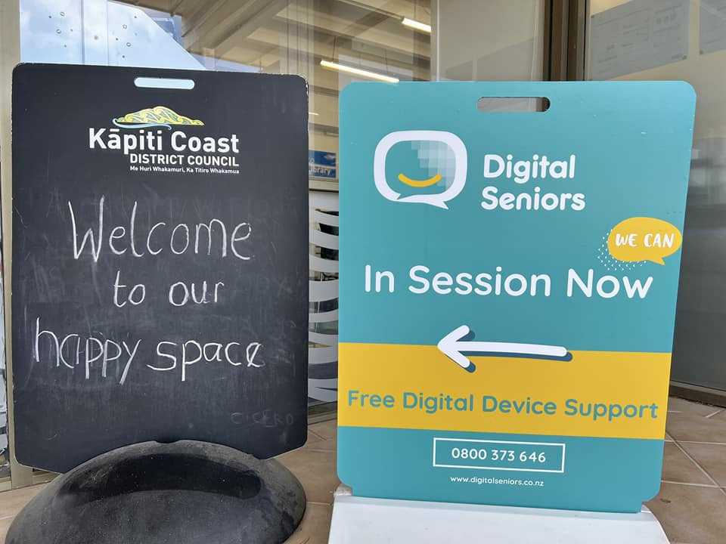
Digital seniors
Grant funding: $17,365
​
Pilot programme for one year ​
​
Digital senior hubs - Ōtaki, Waikanae, Paraparaumu, Paekākāriki to:
Increase senior’s confidence to use technology
Address their technology concerns and interests
Foster a sense of community and reduce social isolation among seniors.
Notes:
Digital seniors Project : underway
Hubs running:
Waikanae Wednesdays 10.30am - 12.30pm Waikanae Library
Paekākāriki Bowling club every second and last Tuesday of each month started
Tuesday 29th October
They are doing an interview on November 5th to talk with volunteers and seniors around the hubs.

Slide 11
Internal work programme
We are working on a range of projects to:
celebrate and showcase what Council currently does to progress an Age Friendly Kāpiti
grow further activation across Council work programmes to contribute to an Age Friendly Kāpiti
support and educate staff on how to embed Age Friendly lens into their work.
Notes:
Internal implementation council:
We are working with our teams in council to celebrate and showcase some of the work that they are doing that is age friendly.
How: as this is an ongoing project, towards an Age friendly Kāpiti, we are continually revisiting and connecting with different teams within council to enbed this in our organisation. Workshop with Managers and Team leaders council.
We are working with our comms team around the different tools and ways we can showcase the Age friendly approach and our mahi within and outside the organisation
And supporting the various teams of council in ways that will help them in their workstream be able to be more age friendly in their work
An age friendly approach video, working on learning tools, working on different ways of engaging with our team and learning more about we can support them,
Age friendly national network, meet of a regular basis nationally. Which give more ideas for resources and tools.

Slide 12
Next steps
Collaborative meeting for all groups to track progress on Age Friendly Kāpiti community projects (February)
A report on the implementation of an Age Friendly Kāpiti completed (June)
The five community projects will be delivered over 2025
We will come back to report impact and achievements early 2026
Annual reporting on the progress of an Age Friendly Kāpiti
Notes:
Reporting:
They will be delivered over the year and we will be coming back early 2026
And a report on progress and projects in the second half of 2025 and following updates twice yearly.

