Slide 1
Te Ara Whetū Update
Waikanae Community Board Tuesday 19 November 2024

Slide 2
programme
1
2
3
4
5
Studio Pacific engaged
Design brief
Building investigation
Demolition & decontamination
Concept design
February 2024
February to April 2024
March to April 2024
April to June 2024
May to September 2024
9
8
7
6
Procurement of main contractor
Resource consent lodged
Preliminary design
Community engagagement
Early 2025
By end of 2024
October to December 2024
September 2024
10
11
12
13
14
Developed design
Detailed design
Building consent
Construction
Opening
December 2024 to March 2025
March to July 2025
Mid-2025
Mid-2025 to late 2026
Late 2026

Slide 3
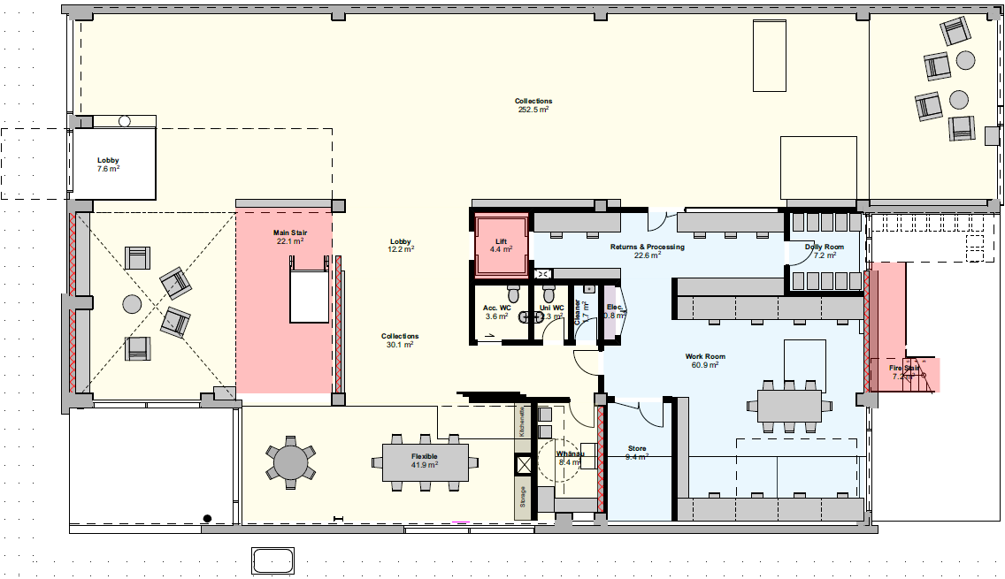
Latest Plans - Ground Floor

Slide 4
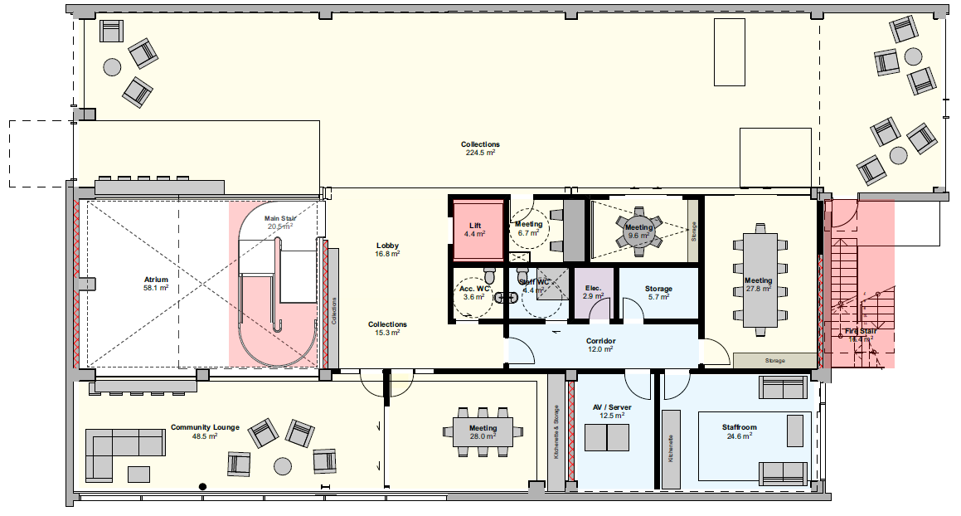
Latest Plans – Level 1

Slide 5
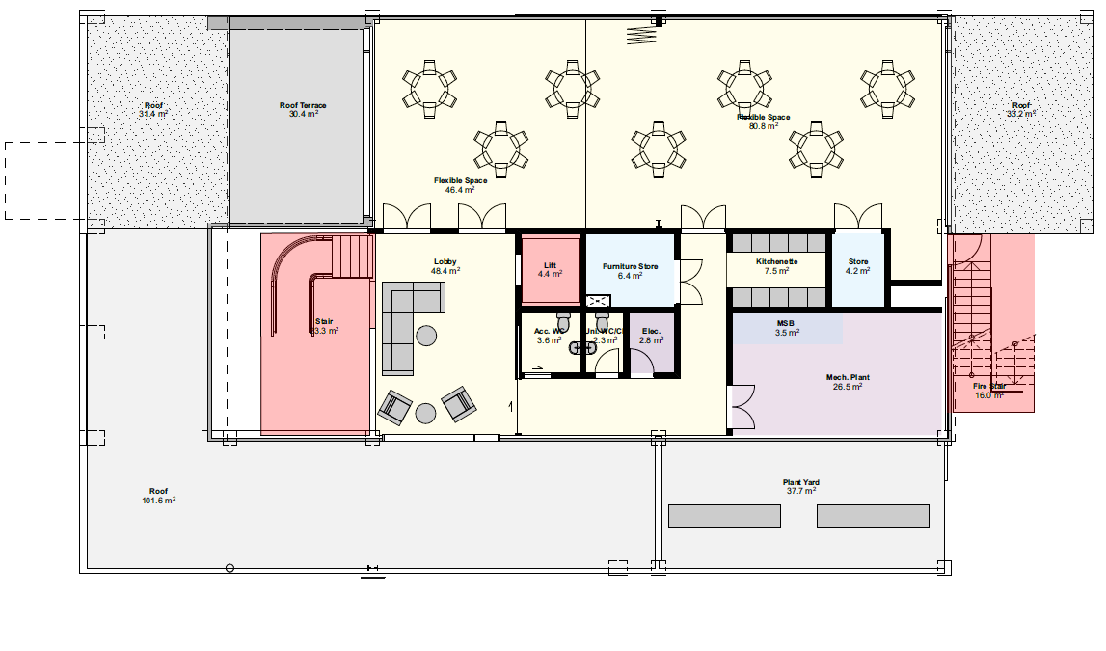
Latest Plans – Level 2

Slide 6
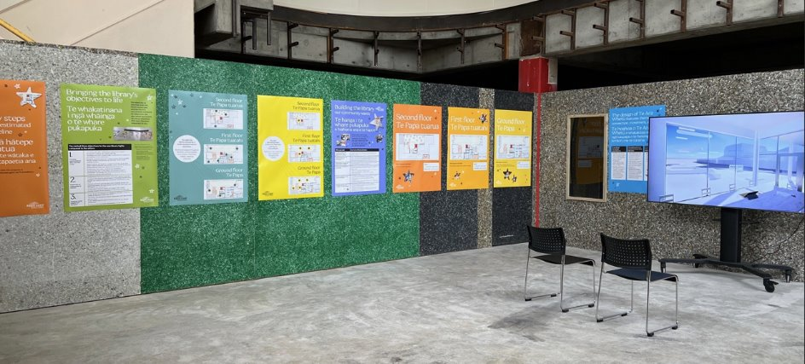
Community engagement
During the week of 9 to 14 September, we invited the community into the old library to view the concept designs.
The objectives of the engagement were to:
show people how their comments influenced the design
inform about next steps and timeline
Give people an opportunity to comment (but no further chance to influence).

Slide 7
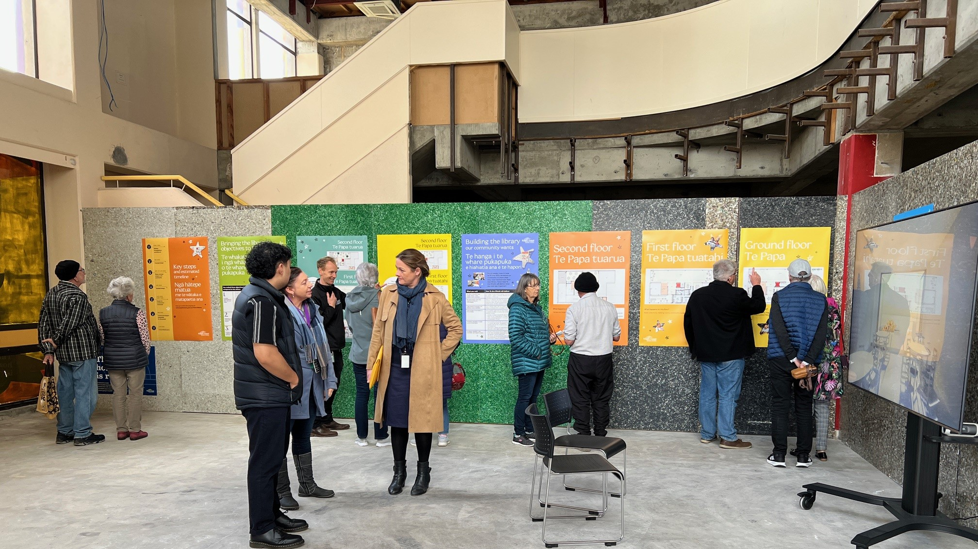

Slide 8
Community Engagement
Hundreds of people called in during the week. They were eager to see the proposed layout and overwhelmingly liked what they saw.
We received 138 comments:
76 were general praise of the concept design
10 related to specific features
3 positive comments about the engagement process and 2 about the name
16 suggestions about the building
16 comments about the library's operations
9 comments about the specific needs of teenagers.

Slide 9
Next Steps
By the end of 2024 we hope to have lodged the Resource Consent and completed detailed design.
In early 2025 we aim to tender for the main construction contractor.
Construction is currently anticipated to commence mid-2025 with an estimated construction period of 12-18 months.
If all goes to plan we will open Te Ara Whetū in late 2026.

Slide 10
QUESTIONS

