Slide 1
Working together for a thriving sector
Presentation to
Te Komiti Whāiti Toitūtanga Pāpori
Social Sustainability Subcommittee
5 November 2024

Slide 2
Social investment
In 2018 KCDC began social investment to strengthen the community and social sector
Together, Kāpiti Impact Trust and Volunteer Kāpiti do the mahi on the ground
Working to upskill, connect & champion organisations & their leaders

Slide 3
The Community and Social Sector is
Values-driven to achieve social goals
Not-for-profit
Located between Paekākāriki and Ōtaki
Independent of local and central government

Slide 4
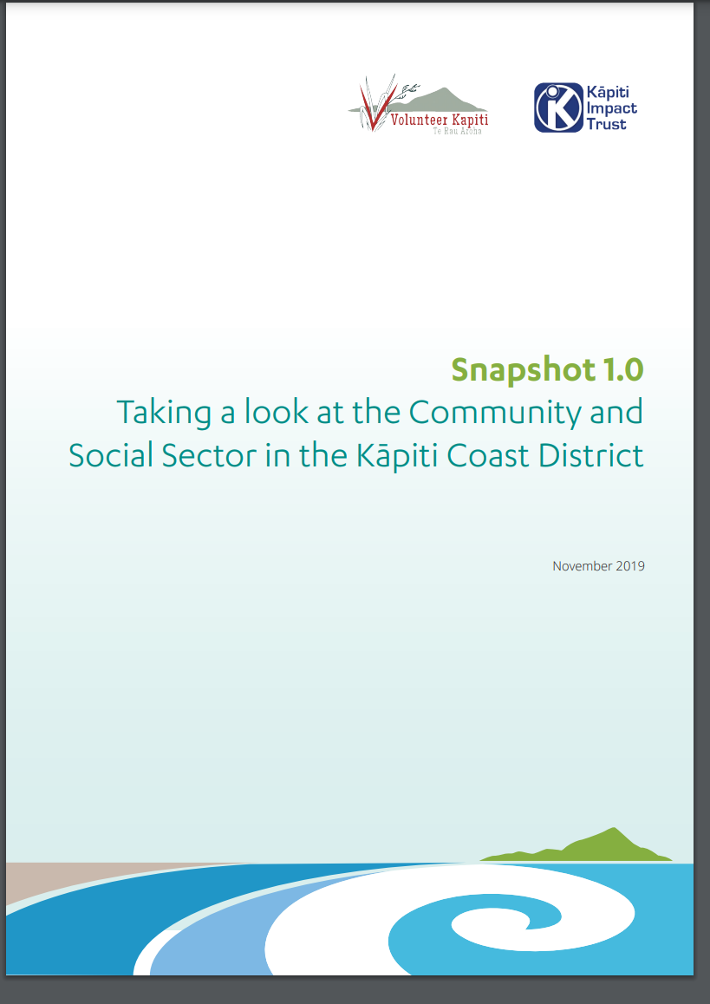
Snapshot 1.0
First time profiling the sector
60+ organisations participated
Surveys and focus groups
Should be repeated
Small organisations, multiple roles
Increasing demand and complexity
Constraints on funding
Expertise, people-focus, passion-led, strengths-based

Slide 5
Lie of the Land
These are especially challenging times

Slide 6
It’s tough out there
Legislative changes
Cost of living crisis
Cuts to government contracts
Ongoing impact of Covid
State of the Sector Report 2024
66% of organisations experience increase in people accessing services
40% of organisations over delivering on govt contracts
45% of organisations are using reserves to fund service delivery
“Survive to 2025” – toughest year in the past decade for organisations

Slide 7
The Cool thing about the Collab is the Combo
Starting with our strengths, drawing on our specialties

Slide 8
Collaboration takes commitment
Mature, specialist organisations
Core mahi focuses on serving other organisations
Synergy – the sum is greater than the parts
By the sector, for the sector
KIT: convene, catalyse, amplify
VK: mentor, train, network

Slide 9
Bang for your buck!
Exceptional value for money

Slide 10
The value-add
Drawing on social capital and social licence of partners
Robust entities with track record, experience & expertise
Volunteering has helped the dollars go further
National networks and influence
Tangata whenua leading engagement with mana whenua
Credibility + acceptance + legitimacy

Slide 11
The proof is in the pudding
The investment is paying off

Slide 12
ROI and SROI
Maturity of the Sector
Communities of Practice
Sector Cohesion and Voice

Slide 13
Here for good
quite literally!

Slide 14
Here to do good & here for the long journey
The Sector will always be here and will always be needed
Focus going forward:
Sustainability
Te Tiriti o Waitangi journey
Sector Visibility and Voice

Slide 15
Here together, for good
The Community and Social Sector share
goals with KCDC:
Making Kāpiti and Ōtaki great
for the people who call this place home

Slide 16
Thanks for the opportunity to share our work
Contact us
Sarah Doherty, Strategic Advisor, Kāpiti Impact Trust sarah@kit.org.nz
Volunteer Kāpiti, manager@vk.org.nz

